Slide 1
Risk Assessment
Unit 5
BTEC Level 3 Diploma for Residential Childcare

Slide 2
What is a risk assessment?
A simple procedure designed to prevent accidents
Required by health and safety law
Required by the Statutory Framework for the Early Years Foundation Stage
Essentially grounded in common sense!

Slide 3
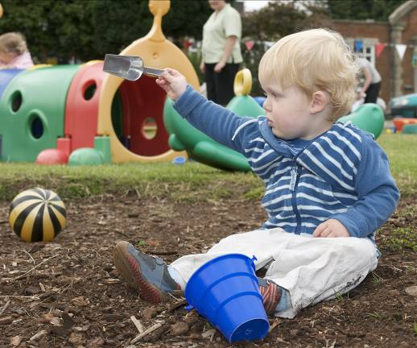
Identification of the hazard
Hazards can be created by:
the physical environment e.g. curled edges on a rug, use of bleach, etc.
developmental factors e.g. inquisitive children, crawling babies, inexperienced staff, etc.
ignorance of policies e.g. not knowing rules regarding using drawing pins, identification and use of the “dirty sink”, etc.

Slide 4
Evaluation of risk
What exactly is the risk?
Injury?
Infection?
Death?

Slide 5
Identification of people
Who might be at risk?
Everyone?
Just visitors?
Children?
Babies?
Inexperienced or new staff?

Slide 6
Calculation of risk
Risk = Probability x Severity
Probability
1. Improbable
2. Possible
3. Occasional
4. Regular occurrence
Severity
1. Trivial
2. Requires first aid
3. Minor injury
4. Disablement or death

Slide 7
Action plan
Can the risk be removed altogether?
Can the risk be reduced to an acceptable level?
How urgent is this?
When should the action be completed?
Who will be responsible for implementing the Action Plan?
Who will check the results and when?

Slide 8
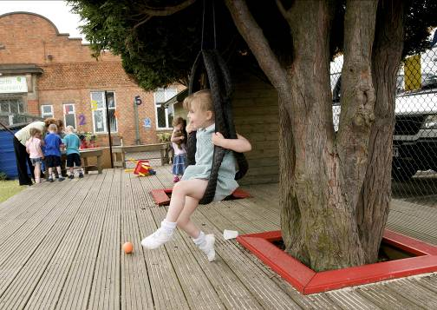
Review Risk Assessments
Reviews should be done at least once a year, or as soon as there is a change e.g. you have a new piece of equipment installed in the garden, you decide to change the floor cleaner you use in your setting.
Ask others (staff, parents, visitors, children) for their opinion, they may see or know about something you don’t.

Slide 9
Don’t forget …
Review
Identify
hazard
Action
plan
Evaluate
risk
Calculate
risk
Identify
people

Slide 10
Activity
Look at the corresponding ‘Risk Assessment’ sheet and carry out your own risk assessment.
Discuss your findings with colleagues and supervisors and use the work as evidence for assessment of your development
Talk this through with your TLC who will assesses your work as evidence of development

