Slide 1
Understand Socially Aware Behaviour
Residential Childcare
Unit 13: Learning Outcome 1
Development of socially aware behaviour

Slide 2
Links between positive relationships & socially aware behaviour
Introduction:
A recent care inquiry stated that “The relationships with people who care for and about children are the golden thread in a child's life. And the quality of a child’s relationships is the lens through which we should view what we do and what we plan to do” (care inquiry 2013)

Slide 3
High Quality Relationships
The experience of positive, safe and stable relationships helps children and young people build secure attachments, develop self-confidence, self-esteem and self-reliance and contributes to a strong sense of identity and belonging.
From the perspective of children and young people, stable, significant relationships are beneficial as they provide someone to turn to at points of crisis and change, they provide encouragement and guidance and they provide endorsement at key life events

Slide 4
High Quality Relationships
In the absence of a secure attachment relationship, some children can find it difficult to trust adults in the face of previously negative and abusive encounters
Secure attachment relationships contribute to the healthy emotional development of children, providing them with skills, competence and capacity to regulate their own emotions, understand others and to form healthy relationships

Slide 5
Social Pedagogy
In different parts of the UK there have recently been great strides to reconfigure services for children and young people in care through the introduction of models that give greater prominence to the importance of relationships and to support these, social pedagogy programmes have been introduced.
Research shows that looked after children who were introduced to this social pedagogy model demonstrates positive views of some young people.
This was the result of positive experiences, such as trips and activities, where children demonstrated a willingness to listen and understand

Slide 6
Better Relationships, Better Learning, Better Behaviour
Understanding acceptable socially aware behaviour extends into schools, who are working promote positive behaviour. Research has shown:
Schools are using a wide range of approaches to encourage positive behaviour, e.g. a curriculum focus on social and emotional wellbeing, restorative approaches, nurturing approaches, peer mentoring, solution oriented approaches
Positive and supportive approaches are increasingly being used far more than punitive methods

Slide 7
Better Relationships, Better Learning, Better Behaviour
Staff in schools feel that ‘promotion of positive behaviour, through whole school ethos and values is a helpful approach to improving behaviour
Staged intervention models have become key components in behaviour relationships and policies

Slide 8
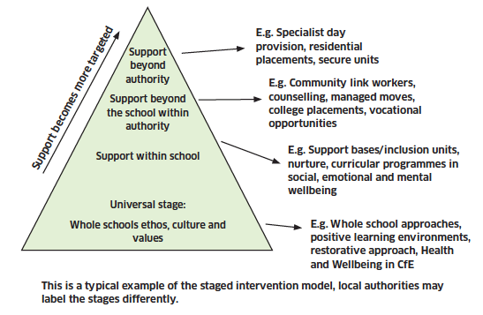
Staged Intervention Model

