Slide 1
The Care System and Its Impact on Children and Young People
Diploma for Residential Childcare
Unit 17
Understanding Social Pedagogy

Slide 2
Theoretical Approaches - Social Pedagogy
Social Pedagogy is an academic discipline that draws on core theories from various related disciplines, such as Education, Sociology, Psychology and Philosophy. In essence, it is concerned with well-being, learning and growth.
This is underpinned by humanistic values and principles which view people as active and resourceful agents, highlight the importance of including them into the wider community, and aim to tackle or prevent social problems and inequality.
The term ‘pedagogy’ originates from the Greek país (child) and ágõ (to lead, to guide). ‘Social’ pedagogy has grown organically out of a longstanding tradition of educational philosophers, social thinkers and practitioners who were concerned with creating a more just society through educational means.

Slide 3
Theoretical Approaches - Social Pedagogy
Social pedagogy interacts between society and the individual. It aims to provide nurturing conditions that support human growth in two opposite directions, towards independence and towards interdependence.
It provides clues about how a given society thinks about children’s upbringing, the relationship between the individual and society, and how society supports its disadvantaged or marginalised members.
Social pedagogues work with all age groups, starting from the early years up to the aged. They work in nurseries and kindergartens, schools, children’s and youth services, play settings, children’s homes and youth clubs; they work in adult services engaging with communities and disadvantaged adults, such as ethnic minorities, substance misusers, homeless, unemployed or imprisoned persons

Slide 4
Theoretical Approaches - Social Pedagogy
Children’s homes that have developed a vibrant social pedagogical culture have generally seen the following improvements:
for children: improved engagement with education and increased educational attainment, improved relationships with staff and peers, a higher sense of involvement and increased happiness and well-being leading to significant reductions in physical restraints, vandalism and absconding as well as improved placement stability.
for staff members: improved well-being and motivation, better relationships with young people, colleagues and other professional groups due to increased confidence, feeling encouraged to be themselves, bring in their own interests and creativity, higher levels of trust and autonomy, and an increased ability to reflect.
for teams: a more positive, non-judgmental culture in the home, increased sense of ownership for the home’s values and vision, improved communication and multi-agency working, and higher staff retention.

Slide 5
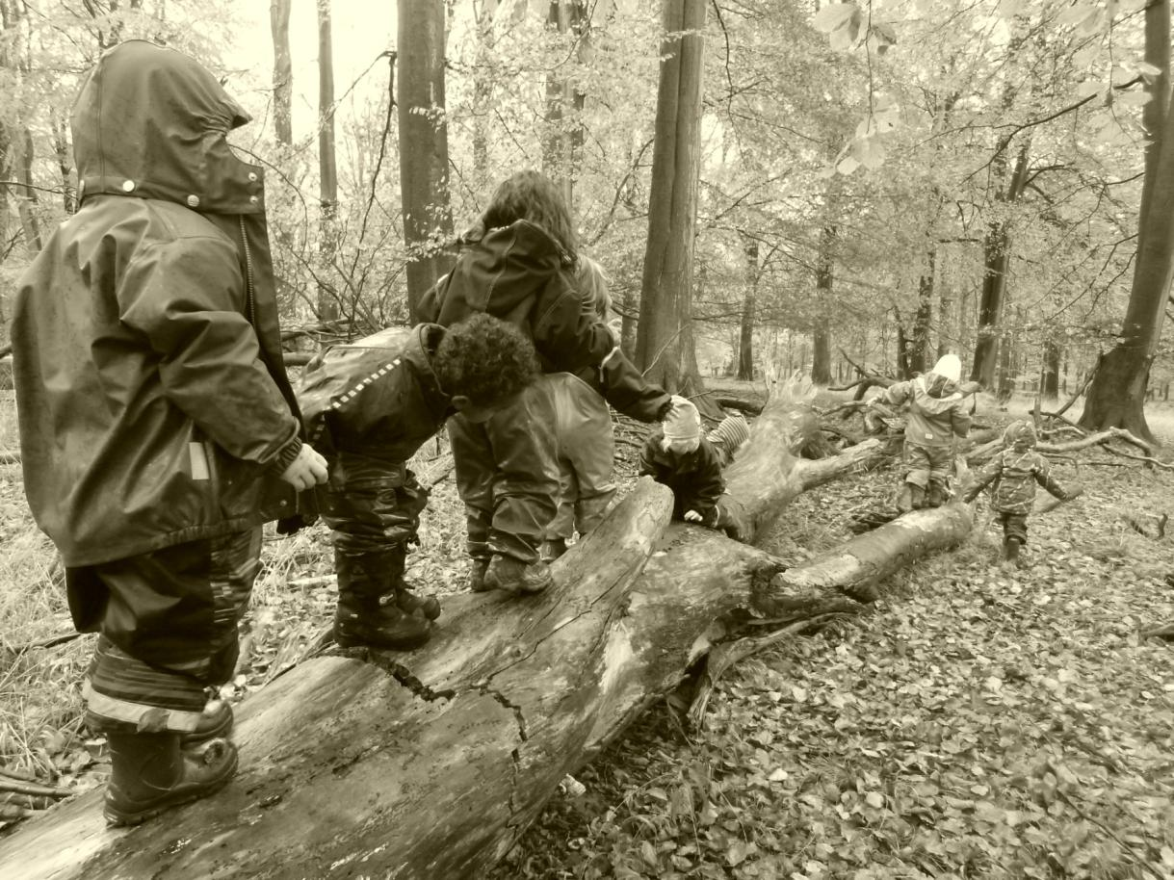
In a Nutshell
Essentially Social Pedagogy is about helping children unfold their potential

Slide 6
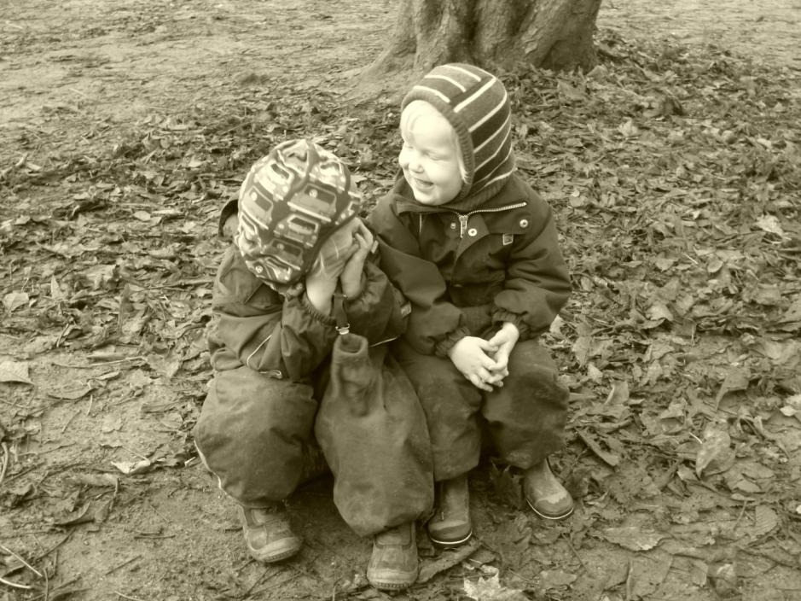
The Hundred Languages of the Child
The child is made of one hundred. The child has a hundred languages a hundred hands a hundred thoughts a hundred ways of thinking of playing, of speaking.
A hundred always a hundred ways of listening of marvelling, of loving a hundred joys for singing and understanding a hundred worlds to discover a hundred worlds to invent a hundred worlds to dream.
Loris Malaguzzi, founder of Reggio Emilia
Notes:
Fundamental to the social pedagogical perspective is our recognition of and regard for each person's human dignity and a concept of children, young people, and all other people, as rich - rich in potential and possibilities, rich in ideas and ways that they can make a difference to our society. So it's about individual agency, about seeing a diamond where others might only see a rock. And it's about helping to make that diamond shine bright. Because, when we enable every member of society to unfold their potential, to bring out their richness and to support others to do the same, we create a more equal, inclusive and thriving community. This wider concern with social inclusion and social justice is therefore reflected in every relationship we build in practice, whether that's the neighbours of a children's home, the teacher of a foster child, or the parents of a young person.

Slide 7
Discovering Potential Means …
Potential is unique
Recognise inner richness beyond behaviour
Holistic – both in how we see children (as whole persons) and how we work with them
Not doing for but with children – creating learning situations in the everyday, focussing on the here and now, and being constantly reflective
Strong and authentic relationships
Attention to social issues: promoting human welfare, addressing social inequality and creating conditions in which all can unfold their potential
“It is not possible to teach, but it is possible to create situations in which it is impossible not to learn.”

Slide 8
The Evolution of Social Pedagogy
“Children are a key to understanding a nation,
not only to comprehend the habits of a society
but also its collective intelligence and sustainability”
(Donata Elschenbroich, German sociologist)
Social pedagogy is a ‘function of society’ (Mollenhauer) that reflects:
how society thinks about children, their education and upbringing (concepts of children);
the relationship between the individual and society;
notions around social welfare and the welfare state.
Therefore, social pedagogy is closely related to society at a given time and place – it is context specific.

Slide 9
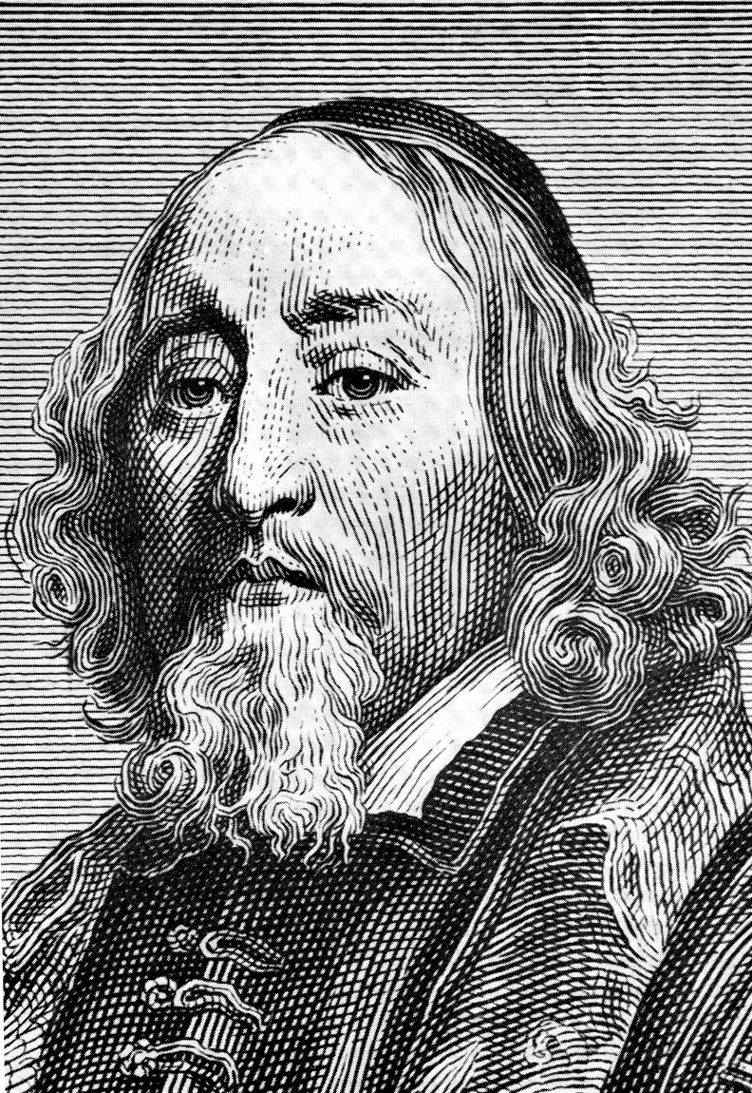
Philosophical Roots
The pedagogue as a gardener, not a sculptor
John Amos Comenius (1592-1670)
’the proper education of the young does not consist in stuffing their heads with a mass of words, sentences, and ideas dragged together out of various authors, but in opening up their understanding to the outer world, so that a living stream may flow from their own minds, just as leaves, flowers, and fruit spring from the bud on a tree.’

Slide 10
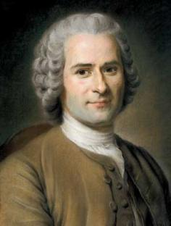
Philosophical Roots
Jean-Jacques Rousseau
(1712-1778)
Upbringing and education in harmony with nature

Slide 11
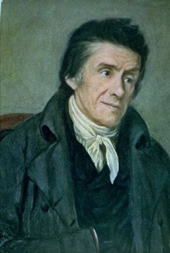
Philosophical Roots
Educating is a holistic process addressing head, heart, and hands
Johann Heinrich Pestalozzi (1746-1827)

Slide 12
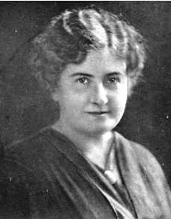
Philosophical Roots
‘The essential thing is for the task to arouse such interest that it engages the child’s whole personality.’
Maria Montessori
(1870-1952)

Slide 13
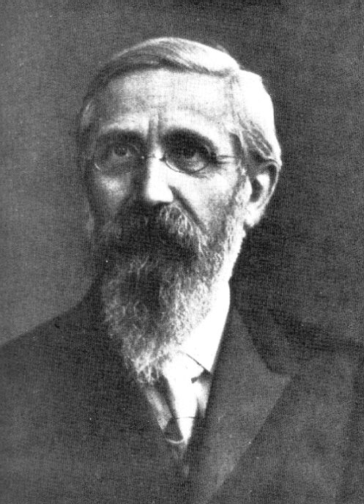
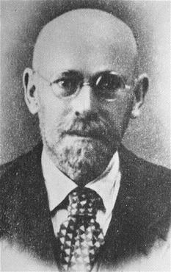
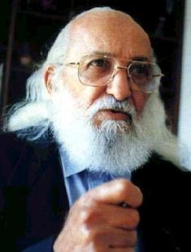
John Amos
Comenius (1592-1670)
Jean-Jacques Rousseau
(1712-1778)
Paul Natorp
(1854-1924)
Johann Heinrich Pestalozzi (1746-1827)
Maria Montessori
(1870-1952)
Janusz Korczak
(1878-1942)
Paulo Freire
(1921-1997)

Slide 14
Social Pedagogy in Europe
Across most of Europe, social pedagogy is a discrete discipline with its own educational qualifications.
Social pedagogues generally study to degree and often to Masters level, although some more practical jobs can be undertaken with an upper secondary qualification. Even this lower level qualification, however, requires two to three years of study.
Social pedagogues are thus significantly better qualified, academically speaking, than their workforce equivalents in the UK, where vocational qualifications are considered sufficient for what are increasingly called social care jobs.
Smith (2012)

Slide 15
Systemic Social Pedagogy
SENSE OF PEDAGOGY
EDUCATIONAL AIM
TASK
pedagogical situation
child
pedagogue
institutional framework
societal-political context
Badry & Knapp, 2003

Slide 16
Impact of Social Pedagogy
Developing reflection individually and in teams:
One team has reflective group meetings each morning, while the children are at school. These have provided a forum to bring issues and develop practice. They are not just about creating a forum for social pedagogy but are also about being pedagogic with each other. This has helped develop more trust in colleagues and has led to more openness and understanding others’ actions and intentions. One of the results is also that the team is less anxious about getting things wrong but feel they can try out new ideas and make mistakes as part of the process. This has relaxed them and improved the atmosphere.
(Children’s home, Essex)

Slide 17
Impact of Social Pedagogy
Professional confidence and sense of purpose:
‘Social Pedagogy has provided a liberation in my thinking and very much connected me to why I became a foster carer in the first place. Although I still have lots to learn, Social Pedagogy is really starting to change my thinking about whole life education, myself, other people and ultimately to what it is to really put our foster daughter front and centre and help her to be all she can be.’
(foster carer, Capstone Foster Care)

Slide 18
Impact of Social Pedagogy
Inter-professional practice:
‘According to [social pedagogy course] participants, the common language and understanding of social pedagogy is making the process of developing effective interventions much faster. They also expressed a strong sense of shared purpose as a result of the training.’
(Orkney social pedagogy evaluation report)

Slide 19
Impact of Social Pedagogy
Involvement of children using a rights-based approach:
‘Before they started to mention all this “pegagogy” thing, they didn't do as much involving us. Normally, the adults make the decisions but, instead, they let us help the adults to make the decisions.’
(10-year-old boy living in Essex children’s home)

Slide 20
The Art of Being …
‘Social Pedagogy, it could be argued, is all about ‘being’ – about being with others and forming relationships, being in the presence and focussing on initiating learning processes, being authentic and genuine, using one’s own personality, and about being there in a supportive, empowering manner. Social pedagogy is like an art form; it’s not just a skill to learn but needs to be brought to life through the social pedagogue’s ‘Haltung’ (her mind set or attitude). In other words, social pedagogy is not so much about what you do, but ‘how’ you do it. This perspective of social pedagogy means that it is dynamic, creative and process-orientated rather than mechanical, procedural and automated. This means it requires a social pedagogue to not be just a pair of hands, but a whole person.’
Eichsteller & Bird (2011)

Slide 21
“The true measure of a man is how he treats someone who can do him absolutely no good.”
Samuel Johnson, English essayist & poet
Notes:
Within a social pedagogical context, we often refer to Haltung, which roughly translates as congruence. It means the way we guide our actions by our beliefs and values. One example at highlights this comes from a Danish children's home. In all of the Danish homes I've been to, the pedagogues always talk about children's parents in very positive terms and highlight the ways in which parents try to be there for their children and how the pedagogues aim to support these relationships. This isn't just empty rhetoric but a genuine belief. So when a mother of one of the young people at this children's home turned up drunk at her son's birthday party, rather than sending her away and suggesting that showing up drunk on such an important day was completely inappropriate, they invited her into the kitchen and made her a cup of strong coffee to sober her up before joining the party. They saw the effort she had made in coming, the fact that she had remembered and the benefit it could have in her relationship with her son. And they found a way of translating their values and principles into action. That's Haltung epitomised.
The example also illustrates one principle that, in my view, characterises social pedagogical practice: behind every behaviour lies a positive unmet need. It's actually one of the fundamental principles of nonviolent communication, which Marshall Rosenberg developed. And it serves as a guiding star for social pedagogical relationships. It encourages us to search for potential, to help a young person - or, as in the example, a mother - find ways of meeting their positive unmet need. It demands that we see the person for who they are and who they could be, not for what they might have done or might do. Nonviolent communication seeks to create an environment in which we can connect as equal human beings, in which we can relate to each other without judging each other and instead empathise with each other, understand the emotions and needs that we have.

Slide 22
The Importance of Love
“I seek education for humanity, and this only emanates through love.”
Johann Heinrich Pestalozzi, Swiss pedagogue

Slide 23
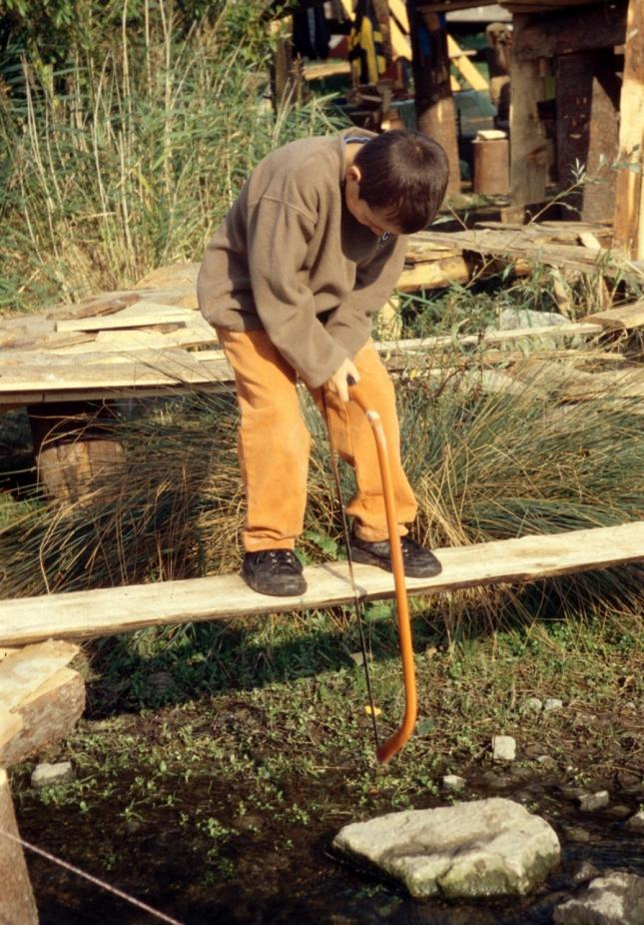
Changing Risk Perceptions
“One should teach children to dance on a tightrope without a safety net, to sleep at night alone under the sky,
to row a boat out on the open sea.
One should teach them to imagine castles in the sky instead of houses on the ground,
to be nowhere at home but in life itself and to find security within themselves.“
Hans-Herbert Dreiske, German poet and social worker

Slide 24
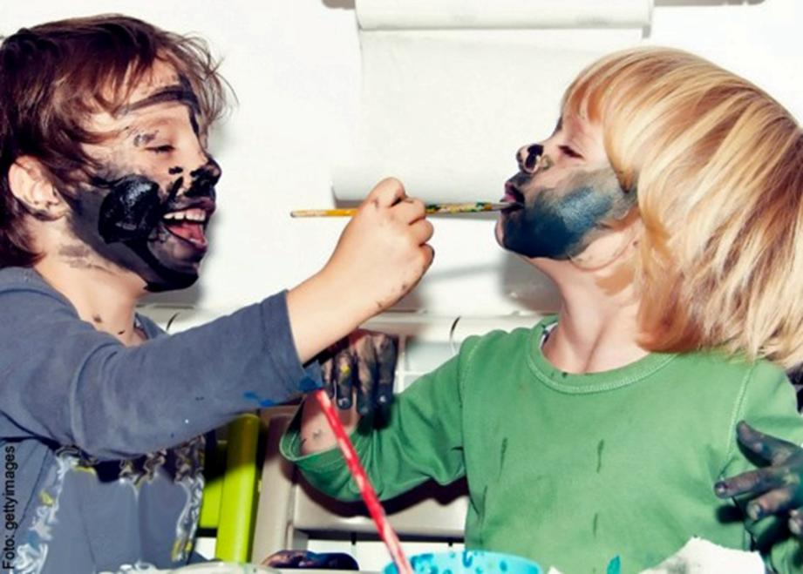
Children as Equals
“Children don’t become human beings, they already are. Children are not the people of tomorrow, but are people of today.”
Janusz Korczak, Polish pedagogue and writer

Slide 25
C4EO Review Report
‘Social Pedagogy appears to offer some promise and, in the context of this review, would exemplify a mode of professional practice that recognises the role of education in both care and learning contexts.’
Centre for Excellence and Outcomes in Children and Young People’s Services (2009). Improving educational outcomes for looked-after children and young people – Research Report.

Slide 26
ADCS Position Statement
‘Children’s Trust partnerships should consider adopting a consistent and holistic approach to underpin the commissioning and provision of support for children and young people across the age range, and their families. One option might be to adopt a system-wide social pedagogical approach to every aspect of intervention and service provision in children’s services including in the professional development of the children’s services workforce. Social Pedagogy is not an evidence-based programme but a conceptual model which can be used as a way of thinking and working across complex systems which in turn could help to further integrate local services - from schools, to healthcare, to specialist care provision - with a common outcomes focus.’
Recommendation 5.3 from ADCS Position Statement ‘What is Care for: Alternative Models of Care for Adolescents’ (April 2013, p.9)

