Slide 1
English Writing
Construct Simple Sentences
Construct Straightforward Compound Sentences
Construct Complex Sentences

Slide 2
Using Sentences

Slide 3
Using Sentences
Writing sentences
Using punctuation
Understanding grammar

Slide 4
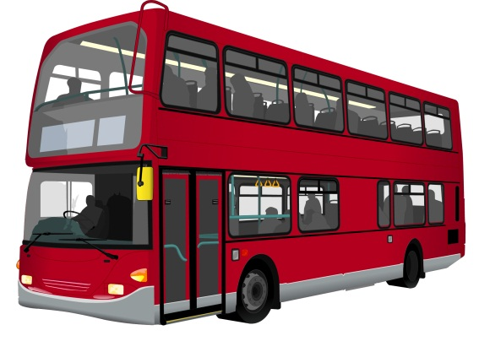
Writing Sentences
A sentence is a group of words that are put together.
Write three sentences about your day so far.
For example…
the bus was late this morning it broke down i told my teacher its not my fault im late

Slide 5
Writing Sentences
For example…
The bus was late this morning it broke down. I told my teacher “it’s not my fault I’m late”.

Slide 6
Writing Sentences
For example…
i gave the cat a different brand of food this morning i wonder if she ate it

Slide 7
Writing Sentences
For example…
I gave the cat a different brand of food this morning; I wonder if she ate it?

Slide 8
Writing Sentences
For example…
ive got £2.50 for lunch i hope thats enough to buy some soup and a sandwich

Slide 9
Writing Sentences
For example…
I’ve got £2.50 for lunch. I hope that’s enough to buy some soup and a sandwich.

Slide 10
Understanding punctuation
What punctuation did you use in your sentences?
Did you use capital letters?
What other things did you use? For example, semi-colons and speech marks.
Was it easy to write the sentences without much time to plan?

Slide 11
Understanding grammar
Words can be written in lots of different orders, for example:
“I couldn’t see through the windscreen that day as there was a lot of dust.”
“As there was a lot of dust, I couldn’t see through the windscreen that day.”

Slide 12
A story in one sentence
Sentences do not need to be long or full of big words to be understood by the reader.
Long sentence:
I came home from school on Monday and made myself a ham and cheese sandwich, sat down to watch TV and then I saw my dog was staring at me.
Short sentence:
My dog was staring at me.

Slide 13
Understanding grammar
Join the following sentences to make a new sentence. Choose a suitable conjunction.
1. I enjoy reading. I don’t enjoy cooking.
2. Ben is thoughtful. He always shares his football with me.
3. Kate walked home from school slowly.
She was tired.
Discussion – What is a conjunction?

Slide 14
Aims and Objectives
This presentation just concentrates on Using Sentences, but you may also look at other English skills you will need to be successful as well.
This helps you understand how each skill is used together with other skills, and helps you use your English skills in everyday life.

