Slide 1
Internet Searches

Slide 2
Introduction
In this session, we will:
learn how to use different ways of searching the Internet
learn about print screen and inserting these into different areas or documents

Slide 3
Using Internet Searches
Using the Internet to search for and locate information can best be achieved by using specific or multi-criteria searches.
A specific search allows you to seek out only information as detailed in your request
A “specific” search should incorporate inverted commas, this will seek out the exact phrase used by you in the search – i.e. “poodles” and press enter to search

Slide 4
Using Internet Searches
Using a multi criteria search allows you to seek out information that may be linked to other information and to do this you may simply use the + sign
I.e. - Car Sales+Harrogate

Slide 5
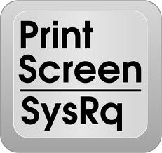
Linking Screen Prints to Internet Searches
A screen print is exactly what it says, a photocopy of the screen you are looking at.
To obtain a screen print you have a button on you key pad marked PrtScn simply click this button and it will copy the screen being shown at the time.

Slide 6
Linking Screen Prints to Internet Searches
To paste a screen print, simply locate the area where you wish this to appear, make sure the cursor is active in this area and simply paste the screen print
A shortcut to paste any item is available by pressing control Ctrl+V at the same time

Slide 7
Practice yourself
To practice this access and Internet Web Browser – Google etc.
Type in “BBC” and press enter
Press the screen print button once
Open a new word document
Press Ctrl+V at the same time to paste

Slide 9
Remember
If you are asked to carry out a specific Internet search, try to use the criteria given. i.e.
A picture of Loch Ness = “Images of Loch Ness”
Museums housed in York = York+Museums

