Slide 1
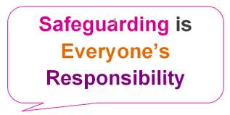
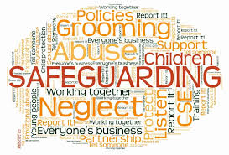
Training package for new members of staff on safeguarding

Slide 2
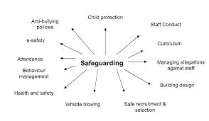
What is the concept of safe guarding?
Safe guarding is the action taken to protect the children from harm. Safeguarding means protecting the children from abuse and mistreatment. It also means that the children are in a environment of safe and effective care.
Schools play an important role in protecting children from abuse. They need to create an environment where the children are protected and safe through safe guarding practises. And ensure the children have the best outcomes in life.

Slide 3
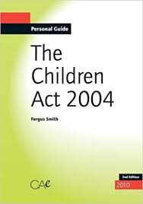
The main legislations of safeguarding
A legislation is a law/rule made by the government.
The children Act 1989 which has now been updated to the children's act 2004 (the 2004 act supplements the 1989 reinforcing the idea) states that the interest of children/young people are the most important in regards of welfare and safe guarding. The Children act 1989 allocates duties to local authorities, parents, and other agencies to make sure children are safeguarded and protected. It focuses on the idea that children are best cared for in their own families however if this is not happening then it makes other solutions for example removing the child from the family home, to provide the child with the best care and to ensure the child is safe. The act contains 47/63 sections( depending which one you read) which the trainee/ new staff should familiarise their self with.
Please copy the link into a web browser and have a read of the children act 1989 http://www.legislation.gov.uk/ukpga/1989/41/contents

Slide 4
The education act 2002
The education act 2002 is an act of the parliament which helps protect the children from extremist/violent views. The same way it helps safe guard children from drugs, gang violence or alcohol. The purpose of the education act is to ensure the children are taught in a way that is lawful and consistent with the laws values. The education act has 9 main sections which you must familiarise yourself with.
Please click the link below to read the education act 2011 which is an updated version of the education act 2002. http://www.legislation.gov.uk/ukpga/2011/21/contents/enacted

Slide 5
United convection on the rights of a child 1989
The united nations convection on the rights of a child also known as (UNCRC or CRC) is a human rights treaty which lays out civil, political, social, economic, health and cultural rights of children. A child according to this convection is any human being under the age of eighteen.
The convection has 54 articles that cover all aspects of a child's life and set out the social, political, civil, economic and cultural rights that children everywhere are entitled too. Every child no matter the gender, religion, language or any other status/abilities has rights. What are the 5 rights of a child? https://www.youtube.com/watch?v=5KQGz-toMnk
Please click the link below and look at the UNCRC and familiarise yourself with it. https://downloads.unicef.org.uk/wp-content/uploads/2010/05/UNCRC_united_nations_convention_on_the_rights_of_the_child.pdf?_ga=2.2890681.861386814.1572544806-84606560.1572544806

Slide 6
Guidelines
A guideline is a general rule/ principle which gives an example to demonstrate something.
Working together to safeguard children is a guide on inter-agency working to safeguard and promote the welfare of children. This guidance applies to all organisations/ agencies who have functions relating to children. This guidance especially applies to organisations such as police, clinical groups and other agencies set out in chapter 2 which will be in the link below. This guideline applies to all schools and every child under the age of 18.
Please click on the link below to familiarise yourself with this guideline. https://assets.publishing.service.gov.uk/government/uploads/system/uploads/attachment_data/file/779401/Working_Together_to_Safeguard-Children.pdf
There are other policies such as safety policy, child abuse policy, bullying policy, date protection , information handling and others which will be covered throughout the slides.

Slide 7
The importance of partnership when working in safeguarding.
Partnership working is when different agencies are working together to protect the child. It is very important when working in safeguarding. Cooperation between agencies is important as it helps lower the risk of cases slipping through the safeguarding system and stopping abuse/neglect at an early stage or even preventing it from happening in the first place.
Agencies such as police, doctors, social services, school or therapists keep in contact with each other so they are all up to date with what is happening with the child and can make strategic plans for that child. Below are a few examples.
Social services- support the individual and their family through the difficult time. They manage care procedures of the child. Their main role is to improve the outcome of the lives of the children. They have to maintain a professional relationship and act as guides.
Police- role of the police is to prevent crime and protect citizens. Criminal offences against children can be sensitive. The police may arrest anyone doing a criminal act towards a child. The police then work with other organisations such as social services in the conduct of any investigation.
The NSPCC- (national society for the prevention of cruelty to children) provide support for children/young people suffering from abuse or domestic violence. They offer support through the phone and may work with other organizations to help reduce/eventually stop cruelty to children in all its forms.

Slide 8
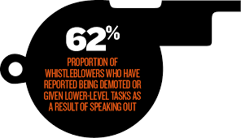
Policies and procedures that are in place to protect children/young people and adults who work with them
It is really important that all professionals follow safe working practices to ensure that not only the children are protected but also the adults who work with them. For example if a child tells a member of staff something it must be taken seriously even if its proven false. The child should be reassured and once the disclosure has been made and the child is protected the designated safeguarding officer should be informed. At Copthorne we have different policies such as whistle blowing, child protection policy and others which will be discussed in more depth throughout the next slides. We also have certain procedures for different situations such as the child protection procedure.
The whistle blowing policy is the reporting of work place concerns. Examples include discrimination, harassment and others which can be viewed in the link below. A whistle blower is a person who comes forward on any wrong doing at the work place. A whistle blower could be an employee, contactor or a supplier who becomes aware of any illegal activity. The procedure at Copthorne is as follows In the first instance of whistle blowing concerns should be reported to the head teacher of the school however if the concern is about the head teacher then they should be reported to the chair of Governers. If the concern is about the governers body then concerns should be made to senior management at Bradford council. On the next slide is a template of a whistle blowing form.

Slide 10
Another very important policy in teaching is child protection. It is a policy that is in place to help protect children/young people. The child protection policy provides guidelines for organizations and their staff to create safe environments for children. A child protection policy also demonstrates an organizations commitment to children and ensures public confidence in its safe practice. At Copthorne we are committed to protect the physical and emotional welfare of every pupil both inside and outside school premises. The policy at Copthorne which will be attached below sets out a clear, consistent framework for delivering this promise in line with the safe guarding legislation and statutory guidance. Abuse/neglect, FGM, forced marriage, child sexual exploitation, homelessness and violence/ criminal activity is all dealt under child protection. If any staff member has any concerns they should report it to a member of the designated safeguarding lead (DSL). This is Stephanie Ngenda, however if she is not available then child protection should be dealt with Emily Kneeshaw, Helen Bradley, Christabel Shepard, Claire Armistead or Suzanne Wood. The school also has a governor for child protection who is Nabil khan. Below is a flow chart on what to do if a child/ young person has been abused/harmed.

Slide 11
The Victoria Climbie case
Failure to follow the child protection procedure could lead to a serious investigation such as the Victoria Climbie case. Victoria Climbie was murdered by her great aunt and her great aunts boyfriend. During the time of her abuse police, social services and the NSPCC all had contact with her and were aware that some sort of abuse was occurring. However failure to properly investigate (the judge described it as ‘blinding incompetence’) what was happening to her led to Climbies death. Her death led to a public inquiry and big changes were made in the child protection policy.
Here is a timeline of what exactly happened to her.
This is why it is very important to report the signs of abuse straight away.
The marks seen on her body

Slide 12
Add in here our school abuse sheet/. Picture this will be how to respond to abuse…

Slide 13
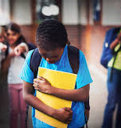
Bullying and its effects
What bullying is?
There is no exact definition for bullying but it is often defined as repeated behavior which is intended to hurt someone physical or emotionally. It could be due to religion, race, gender or sex. There are different types of bullying. Physical assault for example hitting someone. Cyber bullying which is being bullied by a mobile phone or online.
What it can lead too??
Bullying can be very upsetting and can lead to anxiety, depression or even suicide. If you feel like you cant cope you should speak to a doctor or your parents who will be able to help.
What we do at Copthorne
At Copthorne we have a anti bullying policy in which it explains in detail what bullying is and how we tackle it. We believe that all allegations and incidents of bullying should be taken seriously by all staff members and dealt with promptly. Staff will support children involved and investigate. Parents will also become involved and in serious cases police maybe involved.
Please read the link below before moving on.
http://copthorne.ngfl.ac.uk/wp-content/uploads/2015/12/Anti-Bullying-Policy.doc

Slide 14
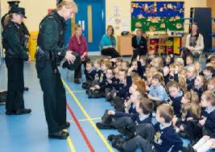
There are many ways in which we work with children/young people to support their safety and well being. For example we have talks with the local police and community officers. Often they come in and visit the children doing presentations on certain topics for example we had officers come in and talk to our children about fire work safety. This led the children to be more aware of the harm/danger of fireworks. It also made the children more confident on approaching the police when something wrong/illegal is happening. E-Safety talks are also given to our children and the children are taught the dangers of online websites/social media. At Copthorne we have an E-safety policy which all members of staff should read in order to comply with the school ethos. We want to teach our children the correct procedures to follow if they see something they should not see or something that upsets them when working with ICT. Children/ young people should have entitlement to safe internet access at all times. Using technology can put children at risk inside and outside school. Dangers may include access to illegal images or content, cyber bullying, illegal downloading of music ect… (more of this is in the E-Saftey policy attached below).
Working with children to support their safety and E-Saftey
The school monitors the impact of the policy using logs of E-Saftey incidents, discussions at children groups and through parent feedback at E-Saftey parent meetings. At Copthorne the head teacher Stephanie Ngenda is responsible for ensuring the safety (including E-saftey) of members of the school community.
There are many ways to reduce risks of the danger online or when using your mobile phone.
Check your privacy settings on social media (make sure nobody can see your address or work place)
Anti virus software should be up to date
Browse the Internet with do not track enabled
Don’t click on random surveys
Clear your browsing history regularly
Don’t give your number out to strangers.
These are all the ways which will make it safer to use the internet/mobile phone!

Slide 15
Please look through the safeguarding package file. Once you have read this, please sign and date it. You are now an expert on safeguarding.

