Slide 1
Childhood Transitions

Slide 2
Transitions
Children and young people naturally go through a number of transitions as they grow up, for example:
being weaned onto solid food
progressing from crawling to walking
being potty trained
going from nursery to primary school
moving from primary to secondary school
transferring from secondary school to college/sixth form
starting work
leaving home.
Can you think of any more?

Slide 3
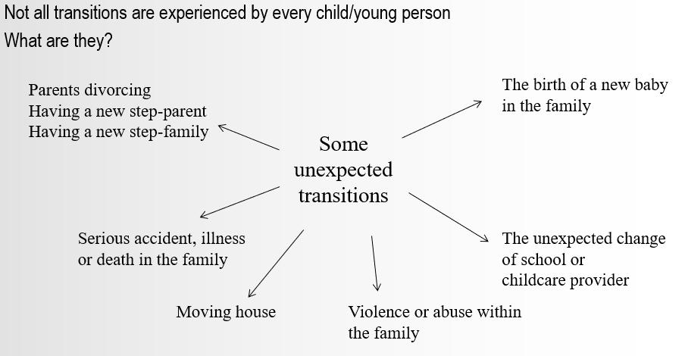
Unexpected transitions

Slide 4
Effects of transitions
Children and young people need to be supported through transitions.
Children and young people who have had many moves or changes may feel a sense of loss or grief.
Some changes may have a profound effect on their emotional and social development.

Slide 5
Activity
DISCUSSION
How can children/young people be supported :
When starting school/nursery?
If their parents divorce/separate?
When a new baby arrives in the family?
What effects might these transitions have?

Slide 6
Activity 2
Reflect on the expected transitions that you have gone through in your life so far.
Think about the effects these transitions had on you.
What support did you get from others?
What more could have been done to help you cope?
As a practitioner, how could you support children and young people when they face similar transitions?

