Slide 1
Manual Handling

Slide 2
What is the safest way to lift a child?
Lifting children is something that you might do many times throughout the day and even more throughout your career!
It is important for the safety of all concerned that you know how to lift safely.
Lifting is best demonstrated to you in an individual way so that your needs (you may have a painful back?) and those of the child can be taken into account.

Slide 3
Safe Lifting
Safe lifting is important to everyone. Most of us lift, lower, push, pull, carry or move many things throughout the day.
Many people have back pain at some stage of their lifetime.
Injuries are usually the result of repeated strain that has happened over many years.
For those who work with and assist children (particularly children with a disability), a great deal of lifting may be required.
This can increase the risk of a back injury. However this risk can be reduced if people understand how to lift correctly.

Slide 4
Lifting Made Safer
Make sure that you have enough space for lifting the right way
Clear away any obstacles
Keep the load in close
Bend your knees
Lift with your legs
Avoid bending and twisting - maintain the natural curves of your spine
7. Brace your abdominal muscles
8. Start and finish the lift at a suitable height off the floor (ideally between knee and shoulder)
9. Avoid lifting or carrying with one hand
Remember that your muscles will get tired after repeated lifting
11. If more than one person is lifting, make sure that you work together, the leader giving commands
12. Always tell the person you are lifting what you plan to do before you do it
13. Wear suitable clothing and footwear when lifting - flat shoes are best

Slide 5
Safe Lifting Techniques
Stop and think.
Plan the lift. Where is the load going to be placed? Do you need help with the load?
Remove obstructions such as discarded wrapping materials.
Place the feet.
Feet apart, giving a balanced and stable base for lifting (tight skirts and unsuitable footwear make this difficult). Leading leg as far forward as is comfortable.

Slide 6
Safe Lifting Techniques
Keep the back straight (tucking in the chin helps).
Lean forward a little over the load if necessary to get a good grip.
Keep shoulders level and facing in the same direction as the hips.
Get a firm grip.
Try to keep the arms within the boundary formed by the legs.
The optimum position and nature of the grip depends on the circumstances and individual preference, but it must be secure.

Slide 7
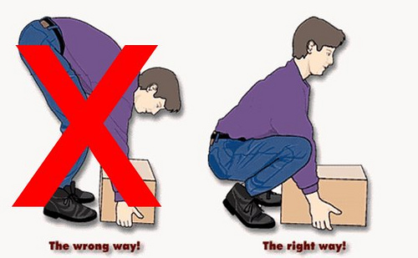
Safe Lifting Techniques
Don’t jerk.
Carry out the lifting movement slowly, keeping control of the load
Put down, then adjust.
If precise positioning of the load is necessary, put it down first, then slide it into the desired position

