Slide 1
Black Lives
Matter

Slide 2
Definition activity: words in the media
White privilege
the belief that people of different races have a different value in society.
the racism that is built into the structure of society and different institutions (like schools, police, government).
Police brutality
Racism
suggests you have some things others do not. Acknowledges that people experience life differently because of their race.
Ally
when the police use too much force and violence against people without a good reason.
Institutional/systematic racism
In this context, a person who supports a cause, even if it doesn’t affect them directly e.g. a White person who supports Black Lives Matter.

Slide 3
Definition activity: words in the media
Anti-racism
was created in 2013 to campaign against violence towards black people and institutional racism.
Movement
a type of campaigning which uses actions and resources to bring about change or accomplish goals.
Unconscious bias
more than just being “not racist”, this means you oppose racism through your beliefs and actions.
this means that you think positively or negatively about different things without even realizing you are doing it. It has been taught to you.
Activism
a loosely organized effort of a large group of people to bring about a goal or goals: the Red Cross Red Crescent is also one. We work together for common goals.
Black Lives Matter Movement

Slide 4
Black Lives Matter movement | was created in 2013 to campaign against violence towards Black people and institutional racism.
Movement | a loosely organised effort of a large group of people to bring about a goal or goals: the Red Cross Red Crescent is also one. We work together for common goals.
Racism | the belief that people of different races have a different value in society and using power and influence against people of a race you value less.
Anti-racism | more than just being “not racist”, it means you oppose racism through your beliefs and actions.
Institutional/systematic racism | the racism that is built into the structure of society and different institutions (e.g. schools, police, government).
Unconscious bias | this means that you think positively or negatively about different things without even realising you are doing it.
White privilege | suggests you have some things others do not. Acknowledges that people experience life differently because of their race.
Police brutality | when the police use too much force and violence against people without a good reason.
Activism | a type of campaigning which uses actions and resources to bring about change or accomplish goals.
Ally | in this context, a person who supports a cause, even if you haven’t directly experienced it e.g. a White person who supports Black Lives Matter.

Slide 5
“Black Lives Matter”
“I can’t breathe”
“Say his/her name”
“Silence is violence”

Slide 6
“We never said only Black lives matter. We know all lives matter. We just need you to help with Black lives matter right now”

Slide 7
Activism and resilience
Supporting people when they have problems is a kind act
Listening to people is an excellent way to support them
Listening to others helps you to understand them
Listening to others is a kind thing to do
Helping people fix problems makes the community stronger
Helping people fix problems makes the community a nicer place to live
Communities should work together
Working together and supporting each other helps people cope with challenges

Slide 8
Listening activity:
Black voices
Clara Amfo
Listen to this speech.

Slide 9
Leigh-Anne Pinnock
“There comes the point in every Black human’s life when you realize racism does not exclude you,"
“My reality is feeling anxious before fan events and signings because I always feel like I’m the least favoured."
"My reality is constantly feeling like I have to work ten times harder and longer to make my case in the group because my talent alone isn’t enough."
“My reality was feeling lonely while touring to predominately white countries where I sing to fans who don't see me, don't hear me, don't cheer me on.”
“My reality is, all the times I have felt invisible within my group, I am fully aware my experience would have been even harder to deal with had I been dark sinned.”

Slide 10
John Boyega
“Black lives have always mattered, we have always been important, we have always meant something, and we have always succeeded, regardless.”
"And now is the time, and I ain't waiting."
“I might not have a career after this”

Slide 11
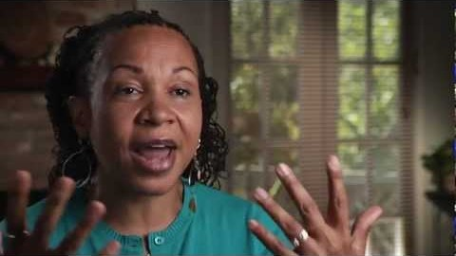
Understanding privilege

Slide 12
What can we do better
Listen to Black voices
Educate ourselves
Reflect on privilege and discrimination
Think about the ways we can all support anti-racism
Be kinder to everyone
Be supportive and help build resilient communities who work together to improve life for everyone

