Slide 1
Managing Personal and Professional Development

Slide 2
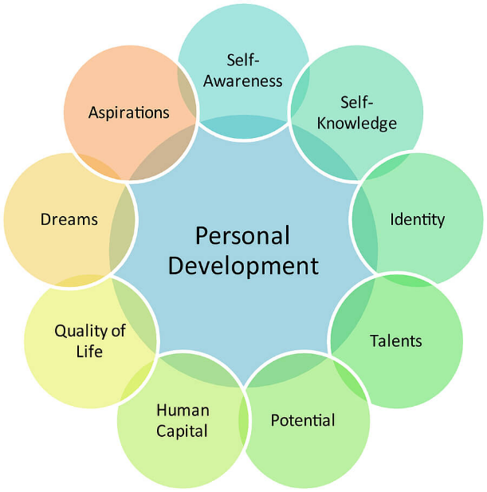
Manage Personal and Professional Development

Slide 3
Intent
By the end of this session you will to identify personal and professional development requirements
In order to achieve this aim you will be collecting evidence from appraisals and provide evidence of how you develop your practice.

Slide 4
Compare sources of information on professional development trends and their validity
Sources of information on professional development trends in their own profession/industry
Such sources could include publications and other information from:
• Professional bodies
• Professional networks
• Trade associations
• Organisation's employee development department
• Training organisations
• Internet
look at strengths/ weaknesses, advantages/disadvantages of each source.

Slide 5
Identify trends and developments that influence the need for professional development
Information on trends and developments in their own profession, industry or organisation that could influence the need for professional development.
These could include changes in :
• Systems or technology
• Market changes
• Competition
• Legislation

Slide 6
Evaluate your own current and future personal and professional development needs relating to the role, the team and the organisation
Information gathered in ACs 1.1. and 1.2 can be used to identify current and future knowledge, skills and experience needs relating to their role, team and organisation. Information sources on current and future needs could also include performance appraisals, job description, business plans, and team objectives.
An evaluation would look at current knowledge, skills and experience levels and the extent to which they satisfy current and potential future needs.

Slide 7
Explain the basis on which types of development action are selected
Identify the different types of development methods available to address the needs identified in section 1.3 including:
• Training courses – including different providers and different learning methods and technologies
• Coaching
• Mentoring
Use those learning needs, learning and development opportunities and preferred learner styles to select the most appropriate training and development actions for the needs identified

Slide 8
SMART Targets
What is a SMART target?
Can you give examples of SMART targets?
S
Specific – say exactly what you will do. Be clear about what it is you want to achieve.
M
Measureable – have a measure that will indicate to you that you have achieved you goal.
A
Achievable – Possible to reach in the near future
R
Relevant – a goal must be meaningful and significant for you and your development
T
Time-bound – Set a date for completion of your identified tasks

Slide 9
How to measure progress and achievement
Can you tell me in your setting how progress is measured?
Appraisals
Feedback from a Tutor/mentor
Feedback from line manager

Slide 10
Feedback
Feedback is important to keep you informed as to how well you are doing and to help you improve.
Feedback should be about performance, not personal.
Ask the person giving feedback how you can improve.
There is always room for improvement.
Why should you always maintain a positive attitude when receiving feedback on your performance.

Slide 11
End of the session- Impact
What have you learnt?
What sources of information can you use to develop professionally?
Name some development actions.
What does SMART mean?

